Slide 1


Slide 2
OUR COMMITMENT ON EDUCATION TECHNOLOGY
SUBMITTED BY :TEAM TERMINATORS
PARUL SEHOTRA
DALBEER SINGH
DEEPANSHI
NIKITA

Slide 3
RECENT TEACHING TECHNOLOGY
Education Technology is the effective use of technology tools in learning as a concept it concerns an array of tools such as media, machines and networking hardware as well as considering underlying theoretical perspective for their effective application.

Slide 4
Gamification of learning
The gamification of learning is an educational approach to motivate students to learn by using video game design and game elements in learning environments.The goal is to maximize enjoyment and engagement through capturing the interest of learners and inspiring them to continue learning. There are two forms of gamification, structural with no subject matter changes, and the altered content method that adds subject matter.Games applied in learning can be considered as serious games, where the learning experience is centred around serious stories. The serious story is "impressive in quality" and "part of a thoughtful process" to achieve learning goals.
In educational contexts, examples of desired student behaviour which gamification can potentially influence include attending class, focusing on meaningful learning tasks, and taking initiative.

Slide 5
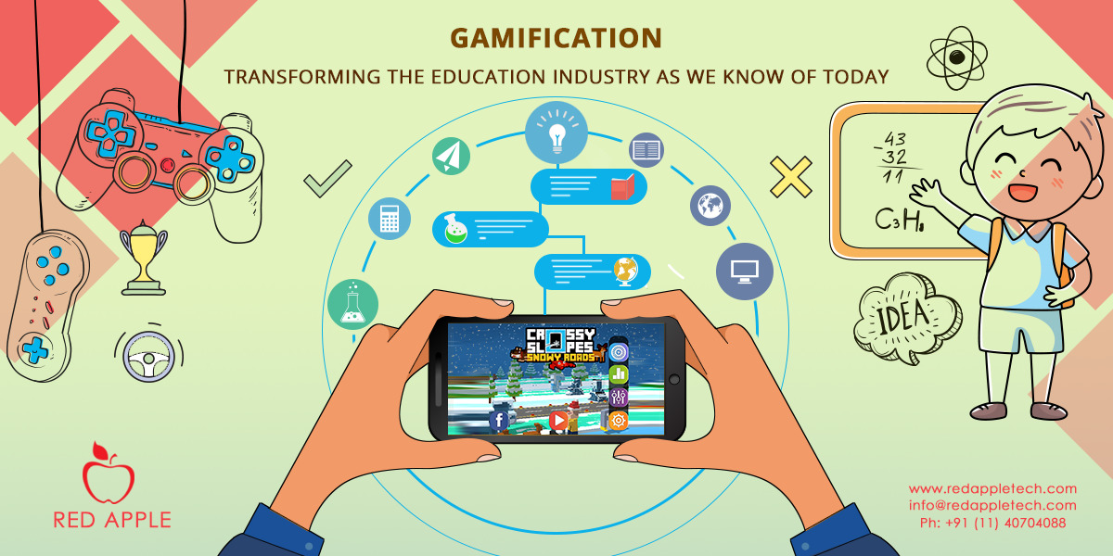

Slide 6
How can I gamify education in my classroom?
Gamification in grading
One success story is Lee Sheldon, a professor at Indiana University, who gamified his course by abandoning grades and implementing an “experience points” system. Students’ letter grades are determined by the number of points they have accumulated at the end of the course, in other words, by how much they have accomplished. Because of the extracurricular interests of the current college-age generation (games!), Professor Sheldon attributes success to the fact that “the elements of the class are couched in terms they understand.” Students are progressing towards levels of mastery, as one does in games. Each assignment and each test feels rewarding, rather than disheartening. Using experience points allows educators to align levels with skills and highlight the inherent value of education.
2. Award students with badges
For each assignment completed, award students with badges. This may seem like a regression back to Kindergarten stickers of gold stars, but it’s working for Khan Academy. As students watch instructional videos and complete problem sets, Khan Academy awards them with points and badges to track progress and encourage perseverance. Western Oklahoma State College is implementing this form of gamification into their technology classes, with badges like “Moodle Noob No More,” or, a personal favorite “Drop It Like It Hot” to indicate mastery of Dropbox. However, as previously noted, it’s important to add value to the badges, like bonus points, skill levels, etc.
3. Integrate educational video games into your curriculum
The use of games allows students to fail, overcome, and persevere. Students are given a sense of agency—in games, they control the choices they make, and the more agency students have, the better students do. Instantaneous feedback and small rewards (or big ones, like winning) are external motivators that work. Case in point, Mr. Pai, a 3rd-grade teacher on a mission to make learning fun. He disrupted the traditional classroom setting by introducing the Nintendo DS, among other technology, into his daily curriculum. Students practiced math and language through the use of computers and video games. In just eighteen weeks, his class went from a below 3rd-grade level to a mid-fourth-grade level.

Slide 7
Game elements that can facilitate learning
Progress mechanics (points/badges/leaderboards, or PBL's)
Narrative and characters
Player control
Immediate feedback
Opportunities for collaborative problem solving
Scaffolded learning with increasing challenges
Opportunities for mastery, and leveling up
Social connection

Slide 8
Benefits
giving students ownership of their learning.
opportunities for identity work through taking on alternate selves.
freedom to fail and try again without negative repercussions.
chances to increase fun and joy in the classroom.
opportunities for differentiated instruction.
making learning visible.
providing a manageable set of subtasks and tasks
inspiring students to discover intrinsic motivators for learning motivating students with dyslexia with low levels of motivation

Slide 9
Effectiveness
The research of Domínguez and colleagues about gamifying learning experiences suggests that common beliefs about the benefits obtained when using games in education can be challenged. Students who completed the gamified experience got better scores in practical assignments and in overall score, but their findings also suggest that these students performed poorly on written assignments and participated less on class activities, although their initial motivation was higher. The researchers concluded that gamification in e-learning platforms seems to have the potential to increase student motivation, but that it is not trivial to achieve that effect, as a big effort is required in the design and implementation of the experience for it to be fully motivating for participants. On the one hand, qualitative analysis of the study suggests that gamification can have a great emotional and social impact on students, as reward systems and competitive social mechanisms seem to be motivating for them. But quantitative analysis suggests that the cognitive impact of gamification on students is not very significant. Students who followed traditional exercises performed similarly in overall score than those who followed gamified exercises. Disadvantages of gamified learning were reported by 57 students who did not want to participate in the gamified experience. The most frequent reason argued by students was 'time availability'. The second most important reason were technical problems. Other reasons were that there were too many students and that they had to visit so many web pages and applications at the university that they did not want to use a new one.

Slide 10
THANKS…….

